Slide 1
Introduction to Information and Communication Technologies
Lecture # 1
Department of Computer Science
CUI Lahore Campus
The slides are adapted from the publisher’s material
Understanding Computers: Today and Tomorrow (Ch1, Ch4)

Slide 2
Course Information
Textbooks
Understanding Computers: Today and Tomorrow, Comprehensive, Deborah Morley, Charles S. Parker, Cengage Learning, 2017.
Python Basics: A Practical Introduction to Python 3, David Amos, Dan Bader, Joanna Jablonski, and Fletcher Heisler, Real Python, 2021
Reference Book
Foundations of Computer Science, Forouzan, B., McGraw-Hill, 2017.
Starting Out with Python, Gaddis, T., Addison-Wesley, 2016.
Problem Solving & Programming, Sprankle, M., Hubbard, J., Prentice Hall, 2012.

Slide 3
Course Evaluation
Theory (100)
4 Assignments (10%)
4 Quizzes (15%)
Mid term exam (25%)
Final exam (50%)
Lab (100)
4 Assignments (25%)
Mid term exam (25%)
Final exam (50%)
= (Theory obt. /100) * 67 + (Lab obt. /100) * 33
Note: 50% marks mandatory in both Theory and Lab for passing the course

Slide 4
Class Expectations
Come to lectures on time and participate
Keep up with reading material
Complete assignments, projects, etc on time
Submit clean, organized, and to the point reports

Slide 5

Key to Success
Attendance
Pay attention to lectures and keep extra notes
Ask questions
Effort
Do homework on your own. It’s ok to ask others but make your own effort.
Consistency
Keep up with reading, and homework.

Slide 6
Plagiarism Policy
According to this policy, a student's submitted work must be the student's own. In this course, this policy will be applied to all work submitted for grade including exams, quizzes, homework, and projects.

Slide 7
Computers in Your Life
Why Learn About Computers?
Computers are everywhere in today's world, influencing work, education, healthcare, and daily life.
Understanding computers helps individuals adapt to technological advancements.
Pervasive Computing (A World of Computers)
Also called ubiquitous computing, this concept highlights how computers are embedded in everyday activities.
Examples include smartphones, smart homes, and AI-driven applications.
Computing is no longer limited to desktops or laptops but is integrated into daily life.
Basic Computer Literacy
Knowing how to use and understand computers is a fundamental skill.
Computer literacy is essential for employment, communication, and education.

Slide 8
Computers in Your Life
Question from previous slide
how computers have become an integral part of modern society and why learning about them is crucial for everyone.?

Slide 9
Computers in Your Life
Before 1980
Computers were large, expensive
Very few people had access to them
Computers were mostly used for high-volume processing tasks
Microcomputers in the early 80s
Inexpensive personal computers
Computer use increased dramatically
Today
More than 80% of US households include a computer, and most use computers at work
Electronic devices are converging into single units with multiple capabilities

Slide 10
Computers in the Home
Computers used for a variety of tasks:
Looking up information and news
Exchanging e-mail
Shopping and paying bills
Watching TV and videos
Downloading music and movies
Organizing digital photographs
Playing games

Slide 11
Computers in the Home
Convergence in Home Entertainment:
Computers serve as a hub for movies, music, gaming, and streaming services.
Smart TVs, gaming consoles, and media centers integrate computing power for seamless entertainment.
Dual-Mode Mobile Phones:
These phones can switch between cellular networks and Wi-Fi for cost-effective and efficient communication.
Examples include smartphones that support both mobile data
Wireless Networking:
Wireless technology enables internet access anywhere, from homes to public spaces.
Wi-Fi, Bluetooth, and 5G networks allow seamless connectivity.

Slide 12
Computers in the Home
Computers in Any Location:
With portable devices like laptops, tablets, and smartphones, computing is no longer restricted to desks.
Cloud computing and mobile applications support remote work and communication.
Smart Appliances:
Traditional household devices (e.g., refrigerators, washing machines, thermostats) now include built-in computing and communication technology.
These appliances can be remotely controlled via mobile apps.
Smart Homes:
A central computer system monitors and controls household tasks.
Features include automated lighting, climate control, security cameras, and voice-controlled assistants (e.g., Amazon Alexa, Google Home).

Slide 13
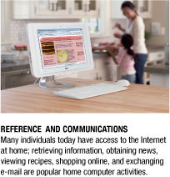
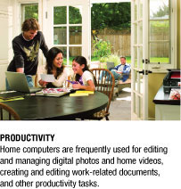
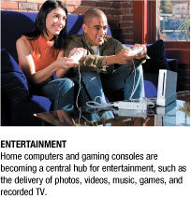
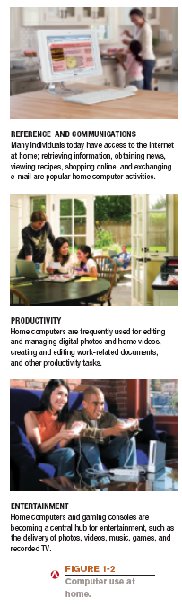
Computers in the Home

Slide 14
Computers in Education
Many students today have access to computers either in a classroom or a computer lab
Colleges and universities are even more integrated
Wireless hotspots allow usage of personal laptops to connect to the college network
Some colleges require a computer for enrollment
Distance learning
Students participate from locations other than the traditional classroom setting using computers and Internet access

Slide 15
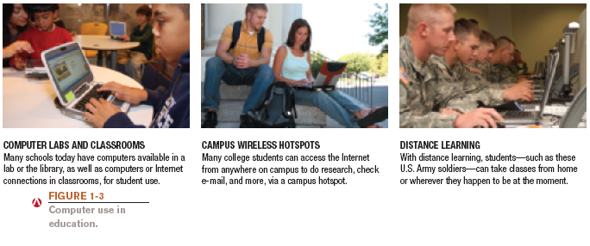
Computers in Education

Slide 16
Computers on the Job
Computers have become a universal on-the-job tool for decision-making, productivity, and communication
Used by all types of employees
Used for access control and other security measures
Use by service professionals is growing
Used extensively by the military
Employees in all lines of work need to continually refresh their computer skills

Slide 17
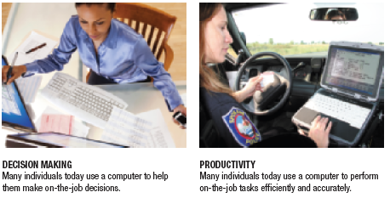

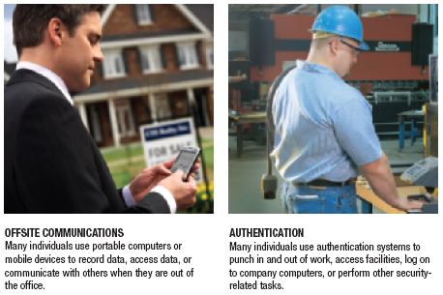
Computers on the Job

Slide 18
What Is a Computer and What Does It Do?
Computer: A programmable, electronic device that accepts data, performs operations on that data, and stores the data or results as needed
Computers follow instructions, called programs, which determine the tasks the computer will perform
Basic operations
Input: Entering data into the computer
Processing: Performing operations on the data
Output: Presenting the results
Storage: Saving data, programs, or output for future use
Communications: Sending or receiving data

Slide 19
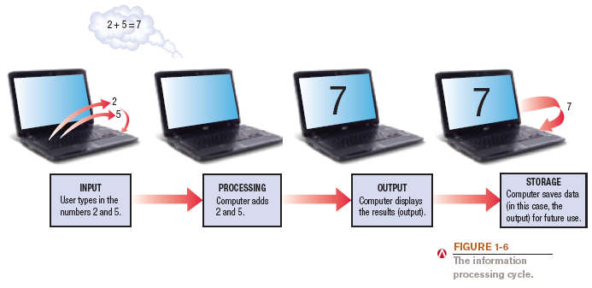
What Is a Computer and What Does It Do?

Slide 20
Advantages and Disadvantages of Using Computers
What are the advantages of using computers?
Reliability
Speed
Consistency
Storage
Communications

Slide 21
Computers to Fit Every Need
Six basic categories of computers:
Embedded computers
Mobile devices
Personal computers
Midrange servers
Mainframe computers
Supercomputers

Slide 22
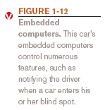
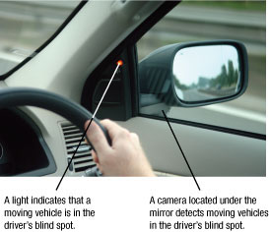
Embedded Computers
Embedded computer: Embedded into a product and designed to perform specific tasks or functions for that product
Cannot be used as general-purpose computers
Often embedded into:
Household appliances

Slide 23
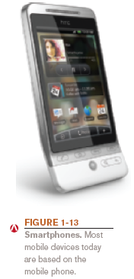
Mobile Devices
Mobile device: A very small device with some type of built-in computing or Internet capability
Typically based on mobile phones
Typically have small screens and keyboards
Examples:
Smartphones
Handheld gaming devices
Portable digital media players

Slide 24
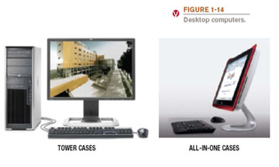
Personal Computers (PCs)
Personal computer: A small computer designed to be used by one person at a time
Also called a microcomputer
Desktop computers: Fit on or next to a desk
Can use tower case, desktop case, or all-in-one (iMac)
Not designed to be portable

Slide 25
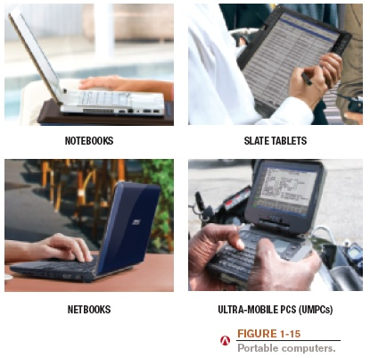
Portable Computers

Slide 26
Portable Computers
Notebook (Laptop) Computers
Designed with a clamshell form factor (hinged screen and keyboard).
Portable and commonly used for work, education, and personal tasks.
Tablet Computers
Two main types:
Slate Tablets: Touchscreen-only devices (e.g., iPad, Samsung Galaxy Tab).
Convertible Tablets: Can switch between tablet and laptop modes (e.g., Microsoft Surface, 2-in-1 laptops).

Slide 27
Portable Computers
Netbooks
Small, lightweight notebooks, often with lower power and cost.
Once popular for basic computing but mostly replaced by ultrabooks and tablets.
Ultra-Mobile PCs (UMPCs)
Handheld computers with full PC functionality.
Designed for portability and used for specialized tasks.

Slide 28
Midrange Servers
Midrange server: A medium-sized computer used to host programs and data for a small network
Users connect via a network with a computer
Midrange servers are powerful computers that fall between mainframe computers and personal servers in terms of computing power, scalability, and cost. They are commonly used by businesses for managing databases, applications.
e.g, Dell PowerEdge Servers

Slide 29
Mainframe Computers
Mainframe computer: Powerful computer used by several large organizations to manage large amounts of centralized data
Standard choice for large organizations, hospitals, universities, large businesses, banks, government offices
Located in climate-controlled data centers and connected to the rest of the company computers via a network
Larger, more expensive, and more powerful than midrange servers
Usually operate 24 hours a day
Also called high-end servers or enterprise-class servers

Slide 30
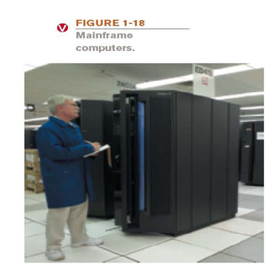
Mainframe Computers

Slide 31
Supercomputers
Supercomputer: Fastest, most expensive, most powerful type of computer
Commonly built by connecting hundreds of smaller computers, supercomputing cluster
Used for space exploration, missile guidance, satellites, weather forecast, oil exploration, scientific research, complex Web sites, decision support systems, 3D applications, etc.

Slide 32
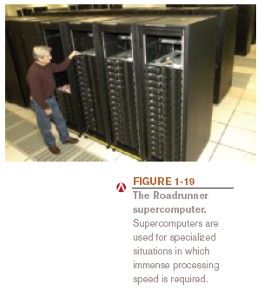
Supercomputers

Slide 33
Quick Quiz
1. A tablet PC is an example of a(n) _____________.
a. Desktop computer
b. Portable PC
c. Internet appliance
2. True or False: The terms mainframe computer and supercomputer are interchangeable; both refer to the largest, most powerful computers.
3. A smartphone is an example of a(n) _____________.
Answers:
1) b; 2) False; 3) mobile device

Slide 34
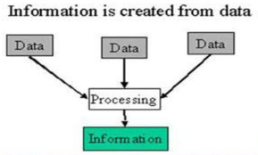
Data vs Information
Data
Data is raw, unorganized facts that need to be processed. Can be in the form of text, graphics, audio, or video
Information
When data is processed, organized, structured or presented in a given context so as to make it useful, it is called information.

Slide 35
Information Technology?
1. Technology
Technology refers to the application of scientific knowledge to create tools, systems, and methods that solve problems and improve human life. It includes both physical and digital innovations across various fields.
Examples of Technology:
Mechanical tools (e.g., cars, engines, industrial machines)
Electronics (e.g., smartphones, televisions, medical devices)
Software and automation systems
Biotechnology (e.g., genetic engineering, medical advancements)

Slide 36
Information Technology?
2.Information Technology (IT)
IT is a subset of technology that specifically deals with computing, data, and digital communication systems. It focuses on managing, processing, and storing information efficiently.
Examples of IT:
Computer hardware (servers, networking devices)
Software development (applications, operating systems)
Databases and cloud computing
Cybersecurity and data protection
IT services (help desks, system administration)

Slide 37
Computers and Society
The vast improvements in technology over the past decade have had a distinct impact on daily life, both at home and at work
Many benefits of a computer-oriented society:
Ability to design products before construction leads to safer products
Earlier medical diagnoses
Devices that allow challenged people to perform job tasks
Documents e-mailed or faxed in moments
Download information, music, programs, movies, and more on demand

Slide 38
Computers and Society
1.Computer Viruses and Malware
What it means: Viruses and malware (malicious software) can harm your computer, steal data, or disrupt systems.
Example: A Trojan horse virus that looks like a useful program but actually installs spyware to steal passwords.
Prevention: Use antivirus software, update systems regularly, and avoid downloading unknown files.
2. Identity Theft and Phishing
What it means: Cybercriminals steal personal information (e.g., credit card details, passwords) by pretending to be a trustworthy source.
Example: A fake email from a "bank" asking you to enter your login details on a fraudulent website.
Prevention: Be cautious of suspicious emails, use strong passwords, and enable two-factor authentication (2FA).

Slide 39
Computers and Society
3. Privacy Issues
What it means: Personal data can be collected, shared, or misused without consent.
Example: Social media platforms tracking your activities and selling data to advertisers.
Prevention: Adjust privacy settings, limit the personal information you share online, and use encrypted communication.
4. Differences in Online Communication
What it means: Online interactions lack face-to-face context, making misunderstandings common.
Example: A sarcastic comment in text may be misinterpreted as rude.
Solution: Use clear language and consider the tone of your messages.
5. Netiquette (Internet Etiquette)
What it means: Guidelines for respectful and polite online behavior.
Example respecting others' opinions.
Tip: Think before you post and be respectful in online discussions.

Slide 40
Models

Slide 41
Turing Model (Turing Machine)
Definition: A Turing Machine is a theoretical model of computation introduced by Alan Turing (1936). It defines how a computer processes information using a simple set of rules.
Components:
Infinite Tape – Memory storage, divided into cells with symbols (0s & 1s).
Read/Write Head – Reads symbols, writes new ones, and moves left or right.
State Register – Tracks the current step in the process.
Rules (Algorithm) – Defines actions based on what is read.

Slide 42
Turing Model (Turing Machine)
How It Works:
The machine reads a symbol.
It writes or erases a symbol.
It moves left or right based on rules.
The process continues until a final state is reached.
Importance:
Foundation of modern computing.
Helps define what problems computers can solve.
Used in artificial intelligence, algorithms, and programming.

Slide 43
Von Neumann Model
Von-Neumann proposed his computer architecture design in 1945 which was later known as Von-Neumann Architecture. It consisted of a Control Unit, Arithmetic, and Logical Memory Unit (ALU), Registers and Inputs/Outputs.
Von Neumann architecture is based on the stored-program computer concept, where instruction data and program data are stored in the same memory. This design is still used in most computers produced today.

Slide 44
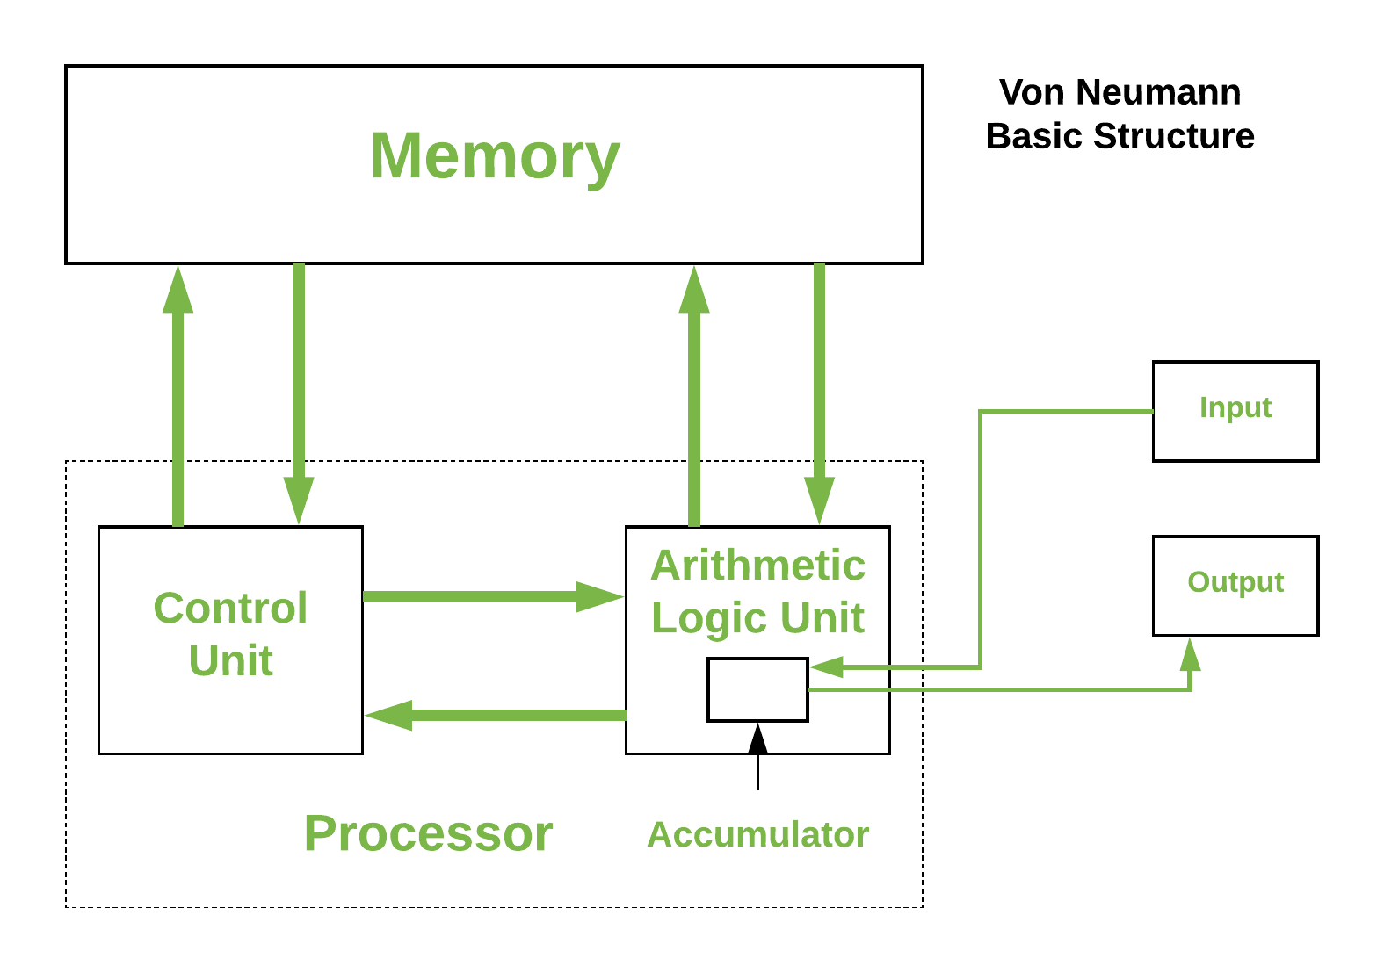
Von Neumann Model

Slide 45
components
The structure described in the figure outlines the basic components of a computer system, particularly focusing on the memory and processor. Here’s a breakdown of the components:
Memory: This is where data and instructions are stored. It is a crucial part of the computer system that allows for the storage and retrieval of information.
Processor: The processor, or CPU, is the central component that carries out the instructions of a computer program. It includes the ALU and Control Unit.
Control Unit: This component manages the operations of the computer. It directs the flow of data between the CPU and other components.
Arithmetic Logic Unit (ALU): The ALU performs arithmetic and logical operations. It is responsible for calculations and decision-making processes.
Input: This refers to the devices or methods through which data is entered into the computer system.
Output: This refers to the devices or methods through which data is presented to the user or other systems.

Slide 46
components
Registers: Small, fast memory units within the CPU.Temporarily hold data, instructions, and addresses during execution.
Example:
Accumulator :This is a register in the CPU that stores intermediate results of arithmetic and logic operations.

Slide 47
Instruction Cycle
The Von Neumann Cycle (also known as the Instruction Cycle) describes how a computer executes instructions based on the Von Neumann Architecture.
Step 1: Fetch (Getting the Instruction from Memory)
The Control Unit (CU) sends a request to Memory (represented by the arrow from CU to Memory).
Memory responds by sending the instruction to the Control Unit (arrow from Memory to CU).
The Program Counter (PC) in the CU keeps track of which instruction to fetch next.
The instruction is then placed in the Instruction Register (IR).

Slide 48
Instruction Cycle
Step 2: Decode (Understanding the Instruction)
The Control Unit (CU) reads the fetched instruction from the Instruction Register (IR) and deciphers what needs to be done.
If the instruction involves arithmetic or logical operations, the CU signals the Arithmetic Logic Unit (ALU) (arrow from CU to ALU).
If the instruction requires accessing memory (e.g., fetching data for calculations), CU sends another request to Memory (arrow from CU to Memory).

Slide 49
Instruction Cycle
Step 3: Execute (Performing the Operation)
If the instruction is an arithmetic or logical operation:
The CU sends the required data from Memory to the Arithmetic Logic Unit (ALU) (arrow from Memory to ALU).
The ALU processes the data and places the result in the Accumulator (small box inside ALU with an arrow pointing to it).
If the instruction is a data movement operation, it directs the data to or from memory.
If the instruction involves input/output, data is either received from Input (arrow from Input to ALU) or sent to Output (arrow from ALU to Output).

Slide 50
Instruction Cycle
Step 4: Store (Writing the Result Back)
If the executed instruction produced a result that needs to be stored:
The Arithmetic Logic Unit (ALU) sends the result back to Memory (arrow from ALU to Memory).
Alternatively, the result can be sent to an Output device (arrow from ALU to Output).

Slide 51
Instruction Cycle
Summary:
The cycle of the Von Neumann architecture is also known as the fetch-decode-execute (FDE) cycle.
How the FDE cycle works
Fetch: The CPU retrieves an instruction from memory
Decode: The instruction is translated into signals the computer understands
Execute: The CPU performs the instruction

Slide 52
Input Devices
In computing, an input device is a piece of equipment used to provide data and control signals to system
Examples
Keyboards, mouse, scanners, cameras, joysticks, and microphones

Slide 53
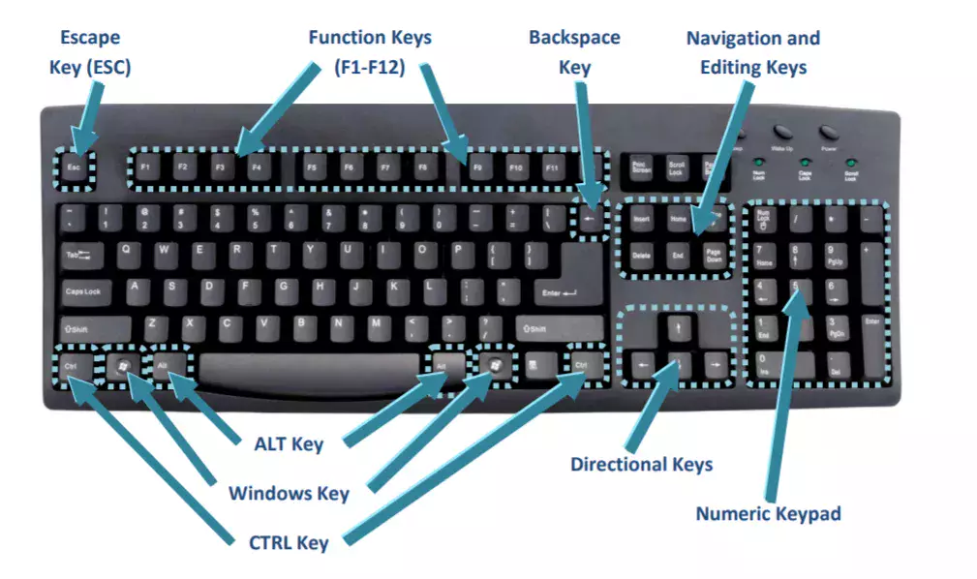
Input Devices (Keyboards)
Keyboard: An input device used to enter characters at the location marked by the insertion point or cursor
Can be wired or wireless
Most computers today are designed to be used with a keyboard
Typically contains:

Slide 54
Input Devices (Keyboards)
1. Escape Key (ESC)
Used to cancel or exit an operation, close pop-ups, or stop loading a webpage.
2. Function Keys (F1–F12)
These keys perform special functions depending on the software being used.
Example:
F1 often opens help menus almost in every software.
Alt+ F4 refreshes

Slide 55
Input Devices (Keyboards)
3. Backspace Key
Used to delete characters to the left of the cursor.
4. Navigation and Editing Keys
Includes keys like:
Delete (removes the character to the right of the cursor).
Home (moves cursor to the beginning of a line or document).
End (moves cursor to the end of a line or document).
Page Up & Page Down (scroll up or down in a document or webpage).

Slide 56
Input Devices (Keyboards)
5. Directional Keys (Arrow Keys)
Used to move the cursor or selection in different directions.
6. Numeric Keypad
Functions like a calculator for quick numeric input.
Includes numbers 0-9, decimal point, and arithmetic operators (+, -, /, *).

Slide 57
Input Devices (Keyboards)
7. Modifier Keys
CTRL (Control) Key: Used in shortcuts (e.g., Ctrl + C to copy, Ctrl + V to paste).
ALT Key: Used for shortcuts and special characters (e.g., Alt + Tab to switch windows).
Windows Key: Opens the Start menu and is used in various shortcuts (Windows + D minimizes all windows).

Slide 58
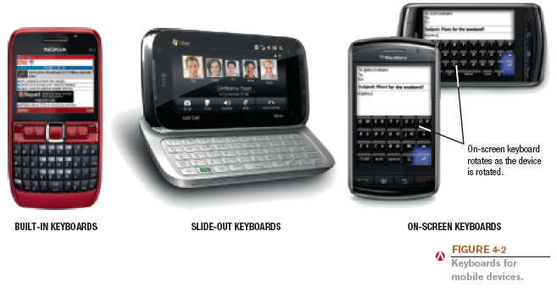
Input Devices (Keyboards)
Portable computers and mobile devices often use:
Built in or slide-out keyboard
Pen or touch input (on-screen keyboard)

Slide 59
Input Devices (Pointing Devices)
Pointing devices: Used to select and manipulate objects
Used to input data
Used to issue commands to the computer
Common types of pointing devices:
Mouse
Pen/stylus
Touch screen

Slide 60
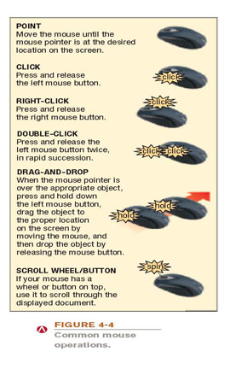
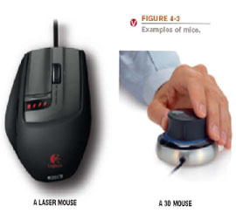
Mice
Mouse: A common pointing device that the user slides along a flat surface to move a pointer around the screen and clicks its buttons to make selections
Older mechanical mice use a ball
Optical or laser mice track with light
3D mice
Can be wireless

Slide 61
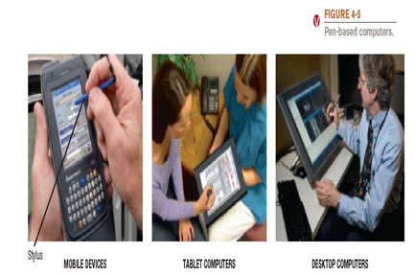
Pens/Styluses
Stylus: Pen-like device used to draw or write electronically on the screen
Also called digital pen, electronic pen, tablet pen
Commonly used with pen-based computers
Used to issue commands and input data
If handwriting recognition is used, written text can be converted to editable typed text

Slide 62
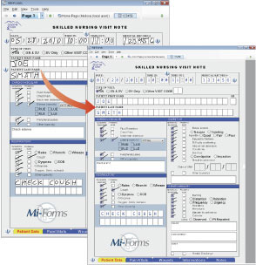
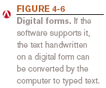
Handwriting Recognition
Digital form: Used to input handwritten data into the computer and then convert it to editable text

Slide 63
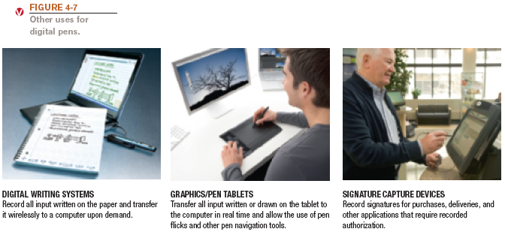
Pens/Styluses
Other uses for pens/styluses:
Digital writing systems
Graphics tablets
Signature capture devices

Slide 64
Touch Screens
Touch screen: Display device that is touched with the finger to select commands or otherwise provide input to the computer
Used with:
Desktop and portable computers
Mobile phones and mobile devices
Consumer kiosks
Can be multi-touch

Slide 65
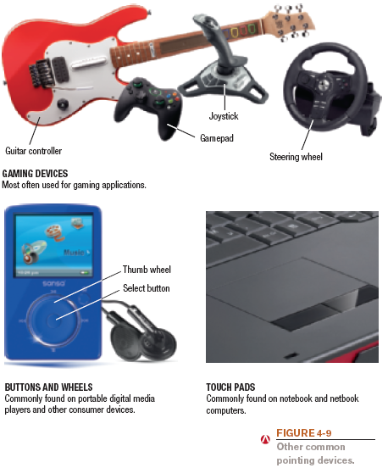
Other Pointing Devices
Other pointing devices:
Joysticks, gamepads, and other gaming devices
Trackballs
Buttons and wheels
Touch pads

Slide 66
Quick Quiz
1. An optical mouse is ____________.
a. the same as a wireless mouse
b. a mouse that tracks movements with light instead of a ball
c. a mouse that contains a scroll wheel on the top
2. True or False: With handwriting recognition, text is input as a graphical image so the text cannot later be edited as text.
3. An input device that looks like an upside-down mouse with the ball on top is a(n) ____________.
Answers:
1) b; 2) False; 3) trackball

Slide 67
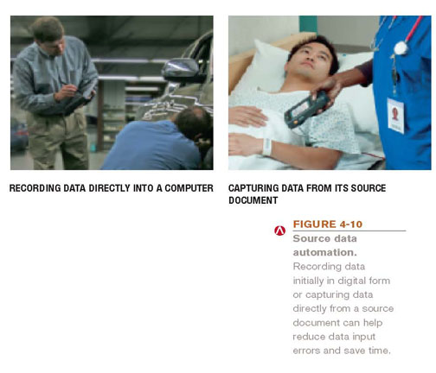
Scanners, Readers, and Digital Cameras
Source documents: Documents containing data that already exists in physical form (order form, photograph, invoice, check, or price label)
Source data automation: Capturing data directly from a source document
Saves time
Increases accuracy
Scanning or reading devices

Slide 68
Scanners
Scanner (optical scanner): Input device that captures an image of an object and transfers them to a computer in digital form
Can scan photos, documents, drawings, (flat objects)
Data is typically input as a single image
If optical character recognition (OCR) is used, text is input as individual text characters
Types of scanners
Flatbed
Portable
Integrated (ATMs, etc.)

Slide 69
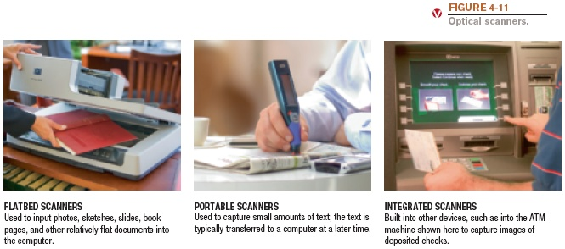
Scanners

Slide 70
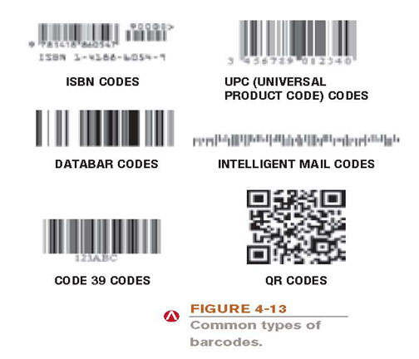
Barcode Readers
Barcode readers: Input devices that read barcodes
Barcode: Machine-readable code that represents data as a set of bars
Common types
Universal Product Code (UPC)
ISBN
Code 39
Intelligent mail code
2D (QR) – hold more data

Slide 71
Biometric Readers
Biometric data: Based on unique physiological characteristics or personal trait
Fingerprint
Hand or face geometry
Iris of the eye
Voice or signature
Biometric readers: Used to input biometric data
Can be stand-alone or built into another piece of hardware
Used to allow access only by authorized individuals
Most often used for access control and to verify transactions

Slide 72
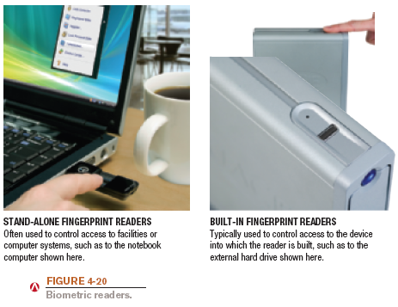
Biometric Readers

Slide 73
Audio Input
Audio input: The process of entering audio data into the computer
Voice input: Inputting spoken words and converting them to digital form
Via microphone or headset
Recorded for narrations, podcasts, etc.
VoIP (Voice over IP systems) applications
To provide spoken instructions to computer (speech recognition systems)
Music input systems are used to input music
Microphones, keyboard controllers, etc.

Slide 74
Output Devices
An output device is any piece of computer hardware equipment which converts information into a human-perceptible form or, historically, into a physical machine-readable form for use with other non-computerized equipment. It can be text, graphics, tactile, audio, or video.

Slide 75
Display Devices
Display device: Presents output visually
Monitor: Display device for a desktop computer
Display screen: Screen built into a variety of devices
Notebook and other portable computers
Mobile phones and mobile devices
Handheld gaming devices, home entertainment devices, kitchen appliances
Digital photo frames, e-book readers
Digital signage systems, digital billboards

Slide 76
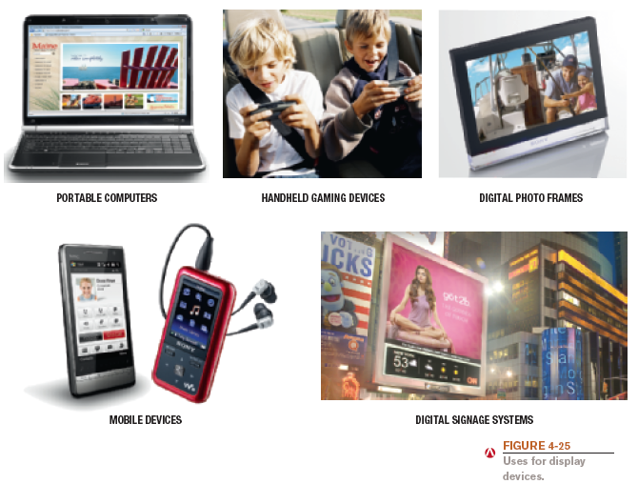
Display Devices

Slide 77
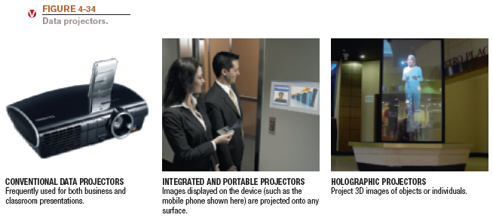
Data and Multimedia Projectors
Data projector: Display device that projects all computer output to a wall or projection screen
Found in classrooms, conference rooms
Can be wireless or integrated into devices

Slide 78
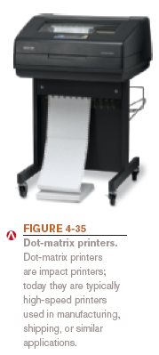
Printers
Printers: Produce hard copy
Printer characteristics
Printing technology used
Impact vs. nonimpact
Color vs. black and white
Personal vs. network printers
Dot-matrix printer
Laser printer
Ink-jet printer
Plotter:
A plotter is a device that receives commands
from the computer and then draws its picture on
the page

Slide 79

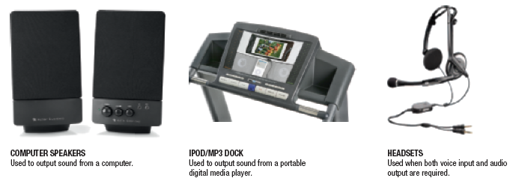
Audio Output
Audio output: Output in the form of voice, music, and other audible sounds
Speakers
Headphones and headsets
Earphones and earbuds

Slide 80
Next Lecture
How Computer Process Data; Central Processing Unit: Control Unit, Arithmetic & Logic Unit, System Clock & Machine Cycle; Memory: Volatile & Non-Volatile, Flash Memory, Registers, Cache Memory; Bus & Types, and Ports.

